Slide 1
Image Compression: Jpeg
Dai’zjon Carney
5/11/2023

Slide 2
What is image compression?
A type of data compression applied to digital images, to reduce their storage cost.
Two types: lossy and lossless
Lossy compression algorithms achieve superior compression ratios by discarding non-essential image data. Leads to some loss in quality, it allows for a significant reduction in file size.
Lossless compression algorithms on the other hand won’t reduce image quality. This algorithm instead eliminates redundant information by encoding data in a more efficient manner without sacrificing any visual loss. Redundancy refers to the presence of repetitive or unnecessary information in a dataset. Multiple types of redundancy.

Slide 3
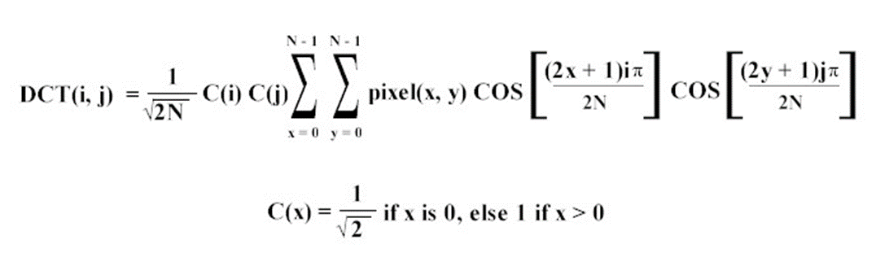
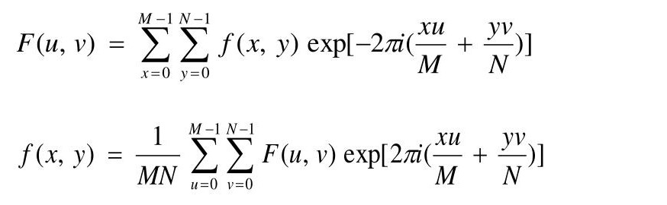
Discrete Cosine Transform
Most popular type of lossy compression.
Expresses image into a combination of cosine functions oscillating at different frequencies.
Implementation:
Divide the image into small blocks: The image is divided into non-overlapping blocks, typically 8x8 pixels each. The 2D DCT is applied independently to each block.
After the DCT is applied, the resulting coefficients represent the frequency content of the image. Quantization is performed by dividing the coefficients by a quantization table. The quantization table determines the trade-off between compression and image quality. Higher values in the quantization table lead to more aggressive compression and potential loss of quality. In my implementation I used a threshold value and formula to implement this quantization. A higher value gives way to higher compression but more quality loss as well.
Its’s then time to apply the inverse 2D IDCT to the coefficients to reconstruct the compressed image.
Concepts that tied into class included transforms (very similar to DFT), thresholding

Slide 4
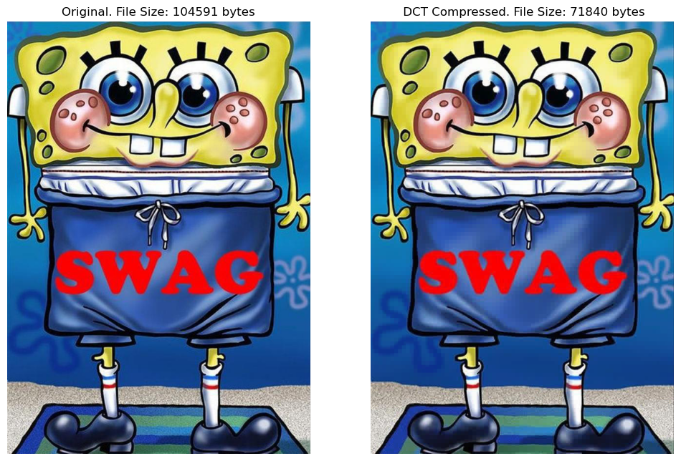
Results
Using a low threshold value to get a compressed image that is lower in size but not too different in quality.

Slide 5
Run Length Encoding
A simple type of lossless compression.
Exploits a redundancy referred to as spatial redundancy which occurs when neighboring pixels in an image have similar values. In most images, adjacent pixels tend to share similarities in color, intensity, or texture. This compression algorithm exploits this redundancy by finding patterns and encoding them more efficiently.
Specifically, run length encoding reduces redundancy in data by replacing repeated consecutive values with a count and the value itself.
For example instead of AAAAAA we have A6
Works best with simple images without a lot of color. (In some cases can make compressed image a bigger size for complex colorful images)
Implementation:
Iterate through the data: Start from the beginning and examine each element in the data.
Count consecutive repetitions: As you iterate through the data, count the number of consecutive occurrences of the same value.
Encode repetitions: When a different value is encountered or the maximum run length is reached, encode the count and the value that was repeated, write to a file.
Repeat until the end of the data: Continue the iteration until the entire data is processed. Decode the encoded file, return the compressed image.

Slide 6


Results
Taking a picture with only one pixel color we can see a great reduction is applied to the size with no loss of quality.
814 B white image from RLE compression | 4.33 KB white image original

